Slide 1


EVENT PARTNERSHIP OPPORTUNITIES
GDG DEVFEST
BARODA 2026
Partner with Baroda’s Thriving Tech Ecosystem
October 25, 2026
TBD

Slide 2
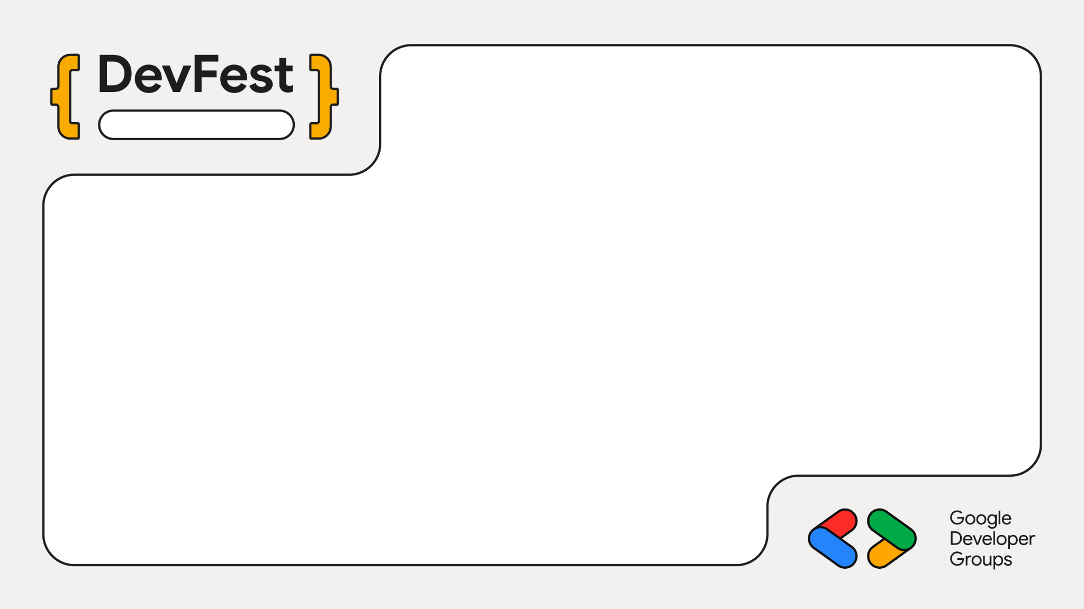
Baroda
GDG Baroda DevFest 2026 Sponsorship Deck

Slide 3
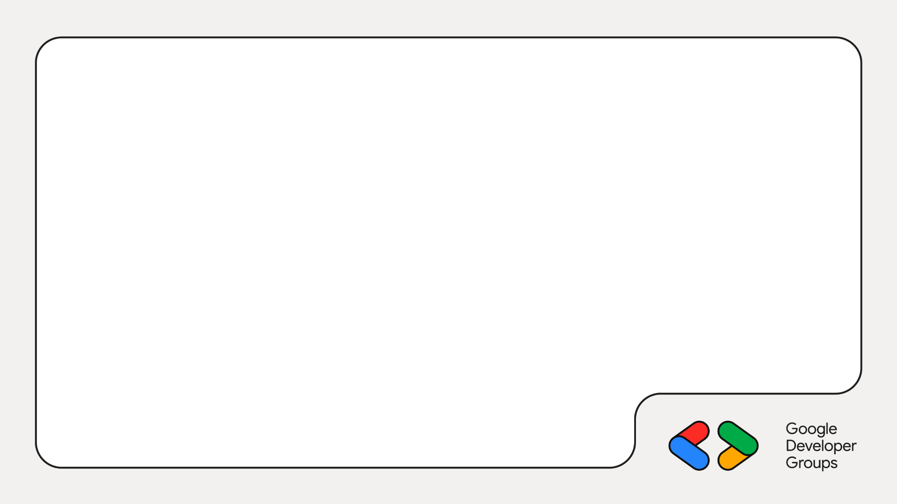
About GDG Baroda
Google Developer Group (GDG) Baroda was founded in
2014 with a mission to empower the local tech community
in Baroda through knowledge sharing, networking, and
hands-on learning experiences.
Today, we're a thriving community of over 5,000+
members passionate about technology and innovation.

Slide 4
About GDG Baroda
5000+ Registered Community Members
Monthly Technical Meetups & Hands-on Codelabs
Annual flagship events like DevFest and Build-with- AI
Collaboration with various communities

Slide 5
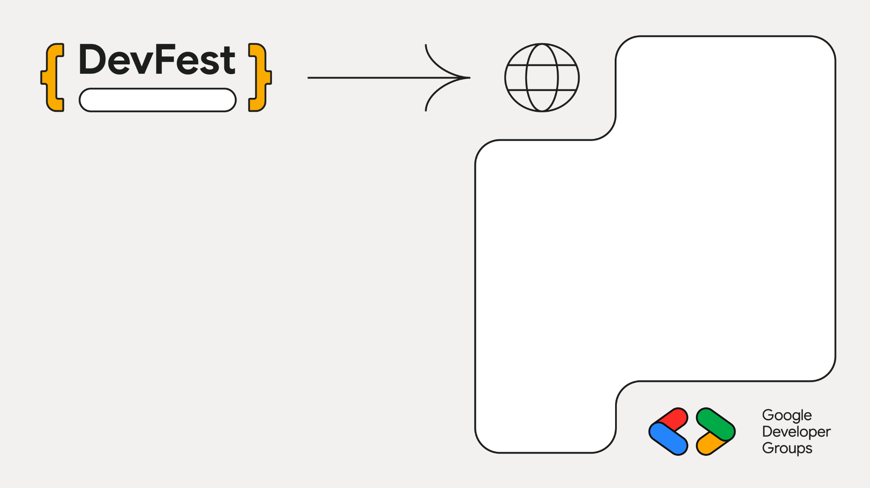
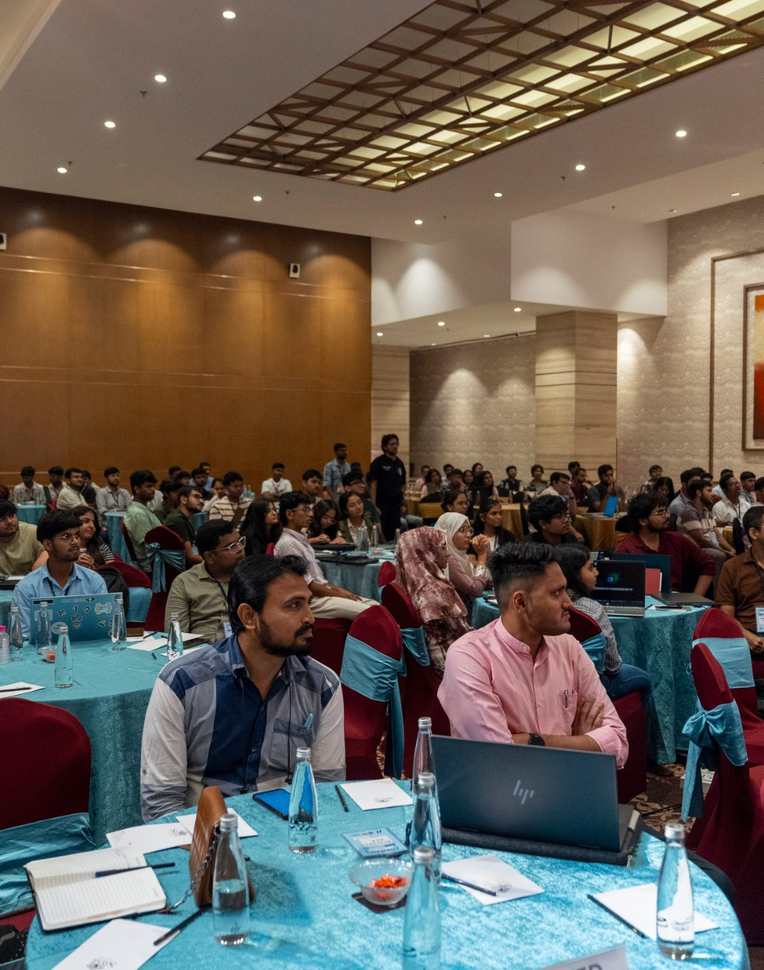
Baroda
About DevFest Baroda 2026

Slide 6
DevFest is GDG Baroda's flagship annual conference,
bringing together developers, tech enthusiasts, and
industry leaders for day full of learning, networking, and
Innovation.
This year's DevFest Baroda will focus on AI, Responsible
AI, and Cloud technologies, featuring speakers from
some of the biggest tech companies in the world.

Slide 7
Expert-Led Sessions
  Insightful talks from Industry leaders and
Google Developer Experts.
Hands on Workshops
  Series of workshops prior to main event reaching almost 1000+ people.

Slide 8
Networking
  Connect with 400+ professionals, industry experts and tech professionals.
Recruitment Opportunities
  Meet potential candidates from different fields and showcase your brand.

Slide 9
Our Audience
DevFest Baroda consistently attracts a diverse audience of
tech enthusiasts, professionals, and students from across
the region. Understanding our audience demographics will
help you maximize your sponsorship impact.

Slide 10
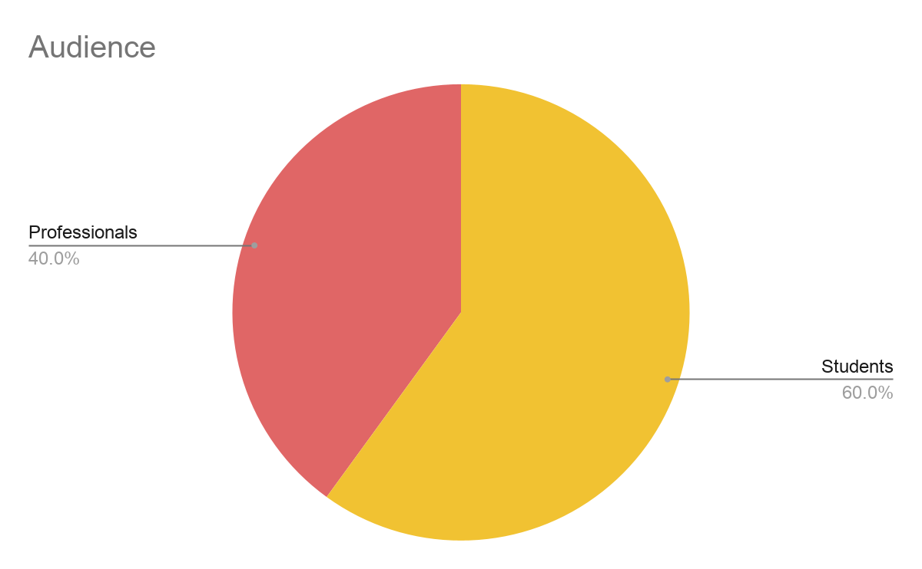
Our Audience
550+
Total Attendees
(Pre-events + Main event)
40%
Professionals
60%
Students

Slide 11
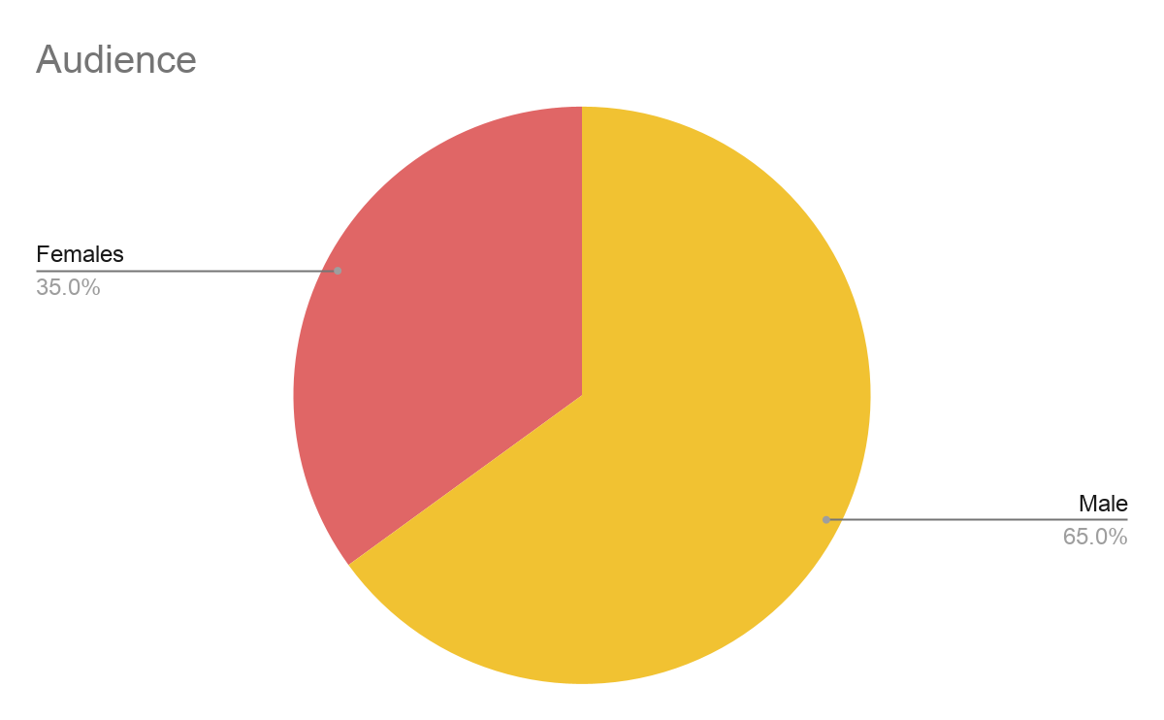
550+ Total attendees (Pre-events + Main event)
35% Women Audience

Slide 12
Sponsorship Opportunities
We offer several sponsorship levels to fit your organization's goals and budget. Each tier provides a unique set of benefits to maximize your brand's impact.

Slide 13
Sponsorship Tiers
Silver
₹25,000 + 18% GST
5 Main Event Tickets
1 Dinner Event Ticket
Logo on Website & Banners
Collaborative Post
Golden
₹45,000 + 18% GST
10 Main Event Tickets
3 Dinner Event Tickets
Logo on Website & Banners
Dedicated Shoutout on Social Media
Collaborative Post
Platinum
₹65,000 + 18% GST
15 Main Event Tickets
5 Dinner Event Tickets.
Collaborative Post
Logo on Website & Banners
Event & Social Media shoutouts
Dedicated Booth Space

Slide 14
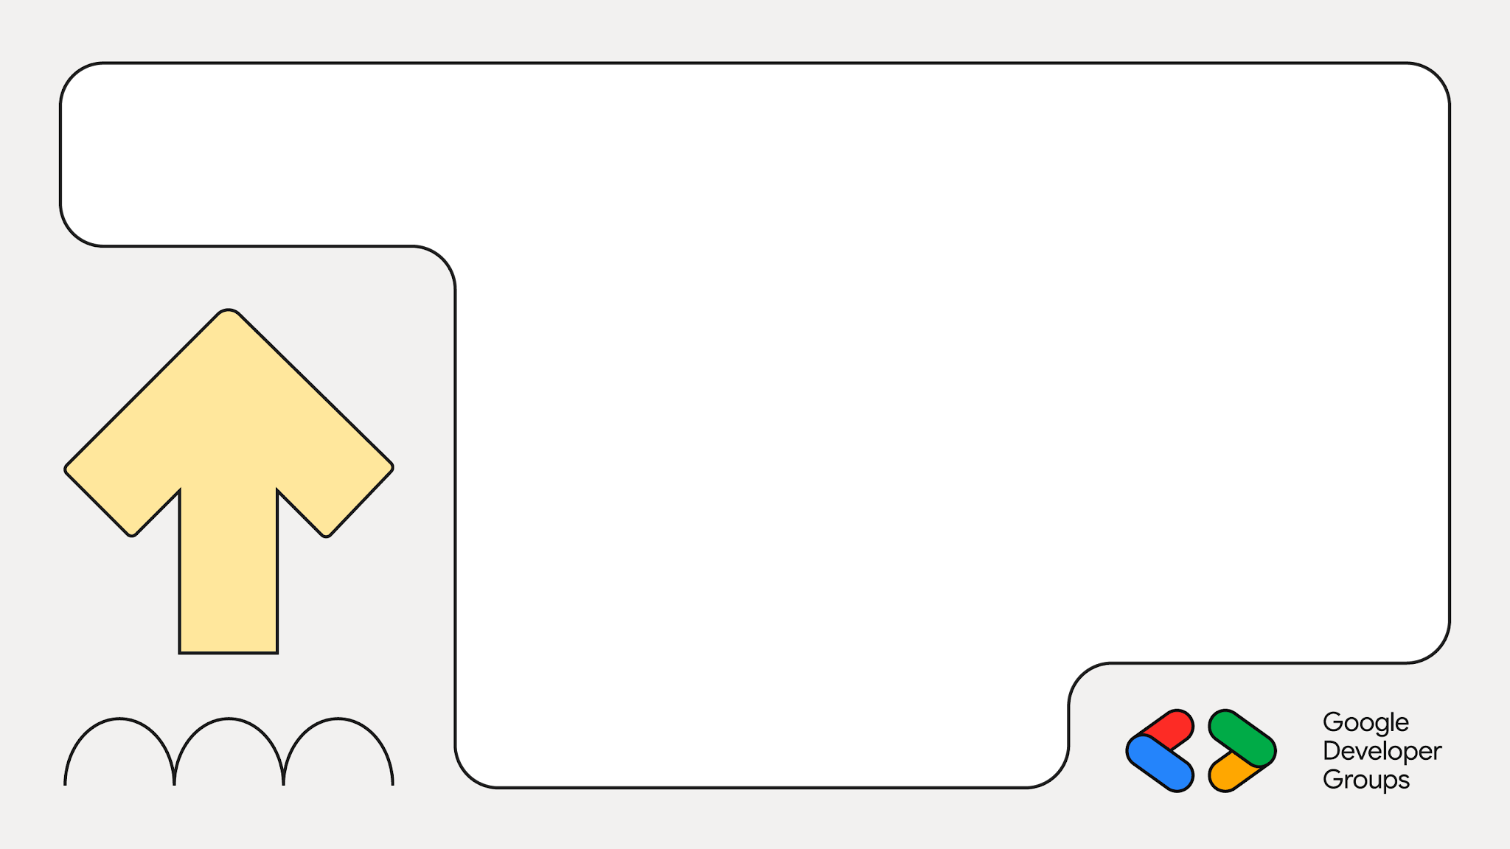
Silver
Build your presence, increase visibility, and connect with the local tech community.

Slide 15
Silver
5 Main Event Tickets
1 Dinner Event Ticket
Logo on Website & Banners
Collaborative Post on Social Media

Slide 16
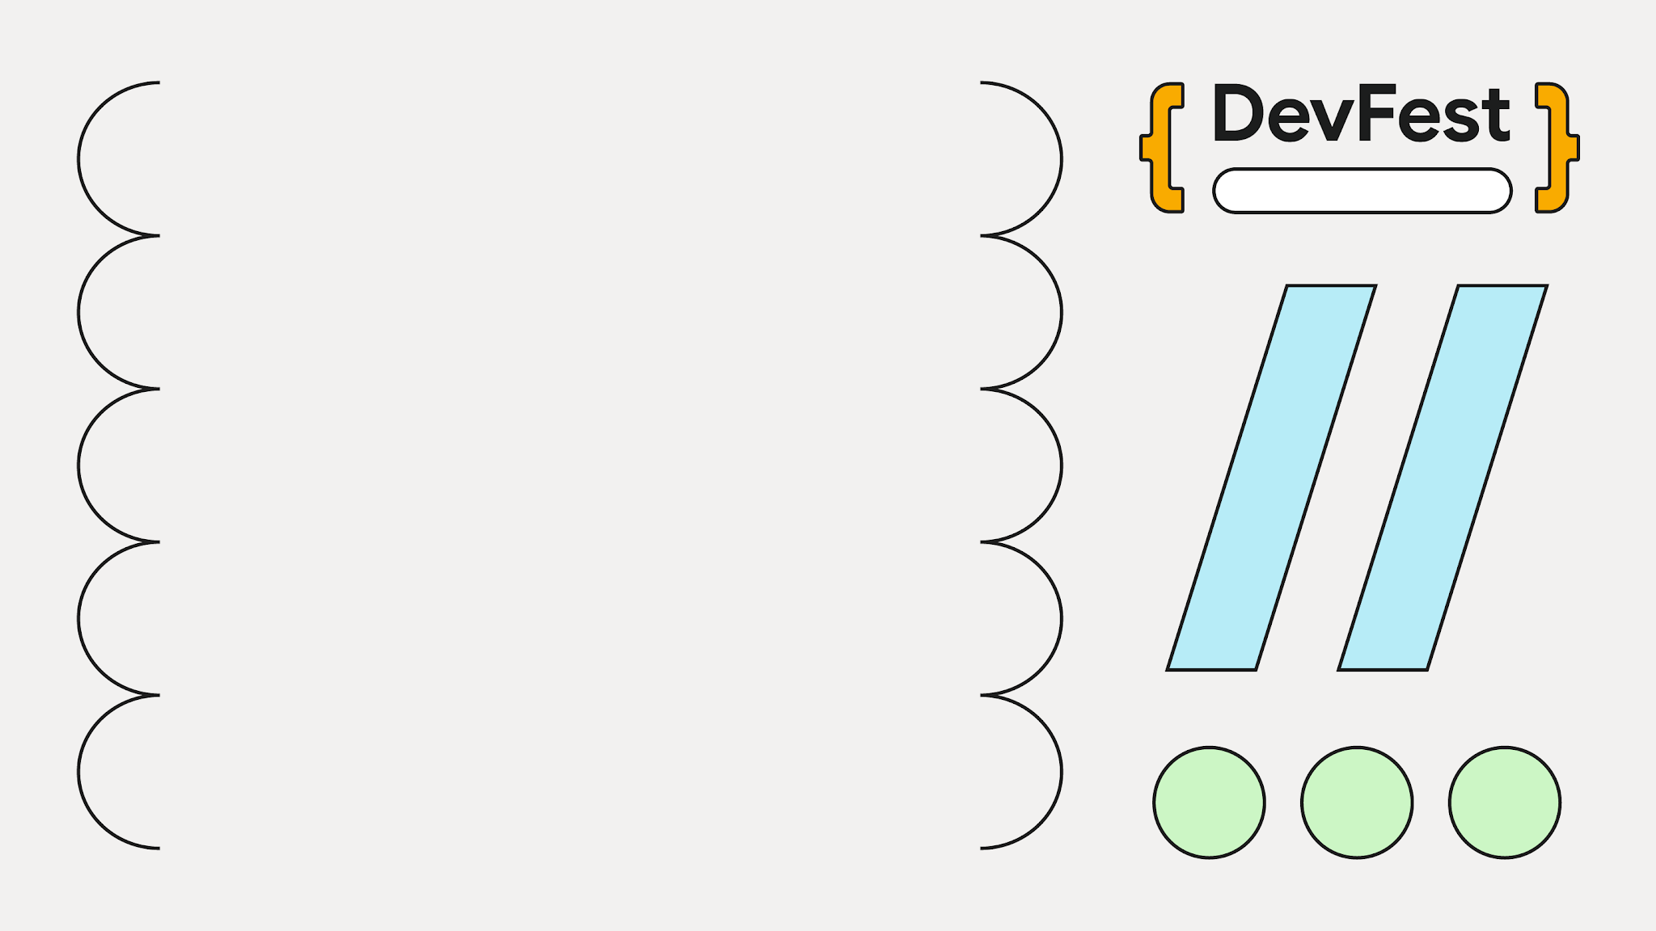
Baroda
Perfect for Startups and organizations looking to connect with local tech talent and grow their presence.

Slide 17
Gold
Amplify your brand, engage directly with attendees, and create meaningful connections.

Slide 18
Gold
10 Main Event Tickets
3 Dinner Event Tickets
Collaborative Post on Social Media
Logo on Website & Banners
Dedicated Shoutout on Social Media

Slide 19

Baroda
Perfect for growing businesses seeking greater visibility and direct engagement
with the DevFest Baroda community.

Slide 20
Platinum
Maximize your brand impact with premium visibility, dedicated space, and deeper community engagement.

Slide 21
Platinum
15 Main Event Tickets
5 Dinner Event Tickets
Collaborative Post on Social Media
Logo on Website & Banners
Event & Social Media
Shoutouts
Dedicated Booth Space

Slide 22

Baroda
Perfect for established brands seeking maximum visibility, premium exposure, and stronger tech connections.

Slide 23


Contact Us
Ready to partner with DevFest Baroda 2026? We're excited to discuss how we can create a mutually beneficial partnership. Reach out to us for more information or to secure your sponsorship.
Dron Trivedi
Organiser, GDG Baroda
gdgbaroda@gmail.com
Custom Sponsorship Packages
Looking for something different? We're happy to discuss custom sponsorship packages tailored to your specific goals. Contact us at gdgbaroda@gmail.com to explore possibilities.

